Slide 1
Development of cement with increased corrosion protection capacity through introduction of powder inhibitor
Serdar, Marijana, Carević, Ivana, Flegar, Matea, Ram, Kiran
University of Zagreb, Faculty of Civil Engineering, Croatia
Miksic, Boris
Cortec Corporation, USA
Rogan, Ivan
CorteCros Ltd, Croatia

Slide 2
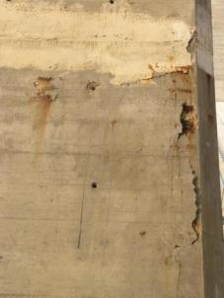
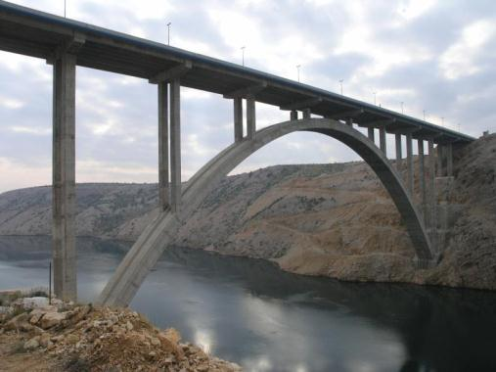

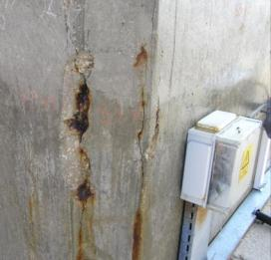
Maslenica Bridge
Built from 1995 till 1996
Heavily corroded 2010
Repair in 2018
https://www.facebook.com/SPEGRA/posts/1827838053997901?comment_id=1849089411872765

Slide 3
Investment in maintanance
https://stats.oecd.org/I

Slide 4
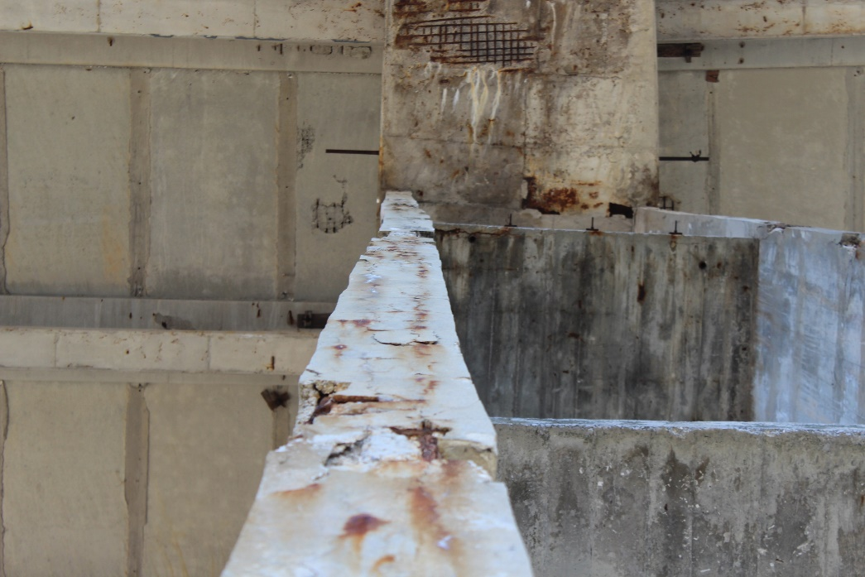
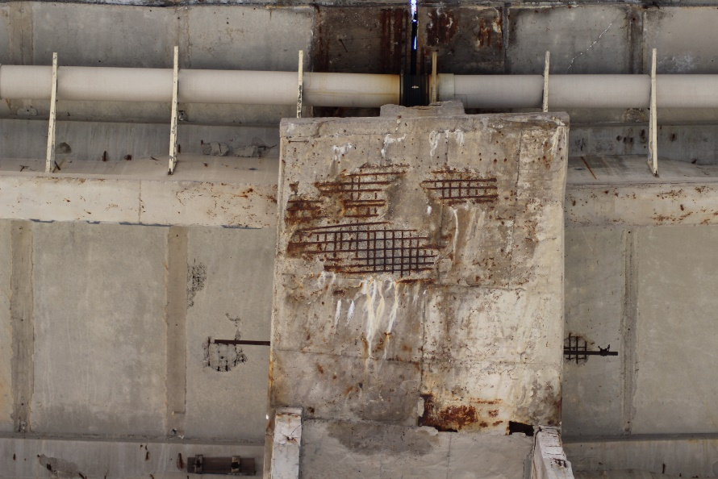
Lack of investment in maintanance

Slide 5
Project idea
Developing materials with better corrosion protection of reinforced concrete structures without complicating the application or prolonging the construction process
The objective of the study was to develop a hybrid cement containing corrosion inhibitor in powder form that can be used like a classical cement but with significantly improved corrosion protection for reinforcing steel
The relevant properties of cement and concrete required for the application of such a cement in the construction industry were systematically investigated

Slide 6
Inhibitor
MCI®-2006 NS is a powder-based, organic corrosion inhibiting admixture for protection of metallic reinforcement in concrete structures
When incorporated into concrete, cementitious grouts, or repair mortars, MCI®-2006 NS forms a protective monomolecular layer on embedded metals that inhibits corrosion
  In new construction - an increase in critical chloride threshold and subsequent reduction in corrosion rates when corrosion does initiate
  In repair mortars and grouts - protects rebar within the patch and is able to migrate into undisturbed concrete adjacent to the repair to protect reinforcement already in place
Aditional benefits
  Biobased (25%)
  Lower toxicity and environmental impact than traditional corrosion inhibiting admixtures such as calcium nitrite

Slide 7
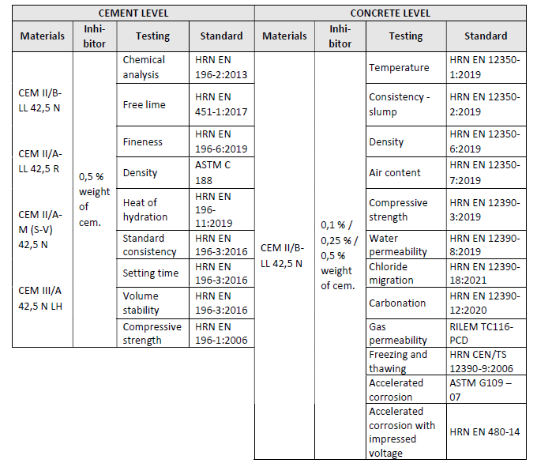
Experimental program
Portland cement with the addition of limestone CEM II/B-LL 42.5 N
Portland cement with mixed addition of slag and siliceous fly ash CEM II/A-M (S-V) 42.5 N
Portland cement with mixed addition of limestone CEM II/A-LL 42.5 R
Mixed cement with slag CEM III/A 42.5 N
Comparison of cement with the addition of MCI-2006 NS with ordinary cements according to the standard HRN EN 197-:1 2012 Cement -- Part 1: Composition, specifications and conformity criteria of general-purpose cement
The aim to determine the influence of MCI-2006 NS powder material as an additive to cement on cement properties

Slide 8
Experimental program
Portland cement with the addition of limestone CEM II/B-LL 42.5 N
Three dosages of inhibitor:
0.1% weight of cement
0.25% weight of cement
0.5% weight of cement
Comparison of concrete prepared with cement with the addition of MCI-2006 NS with the reference concrete exposed to the environmental class (salts from the sea - XS) according to the standard HRN EN 206

Slide 9
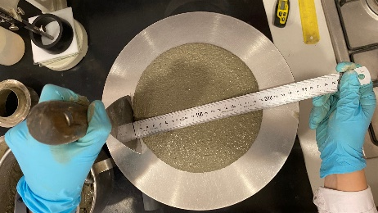
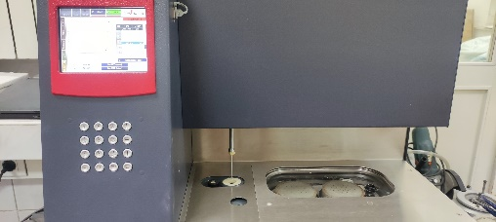
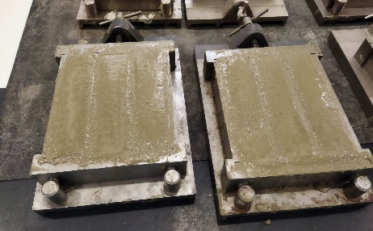
INFLUENCE OF INHIBITOR ON CEMENT PROPERTIES
Cement type | Label
Portland cement with the addition of limestone CEM II/B-LL 42.5 N | CEM II/B-LL 42,5 N
Portland cement with mixed addition of slag and siliceous fly ash CEM II/A-M (S-V) 42.5 N | CEM II/A-LL 42,5 R
Portland cement with mixed addition of limestone CEM II/A-LL 42.5 R | CEM II/A-M(S-V) 42,5 N
Mixed cement with slag CEM III/A 42.5 N | CEM III/A 42,5 N LH

Slide 10
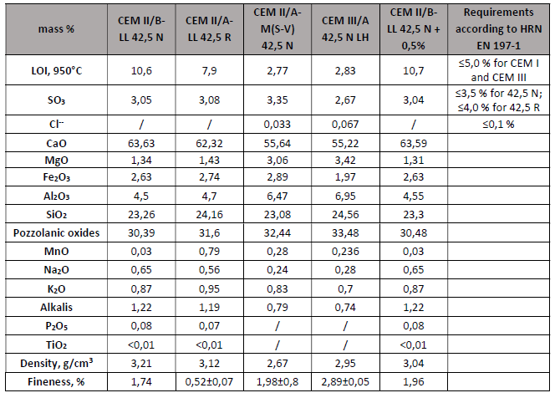
Chemical and physical properties
There are no deviations in the chemical and physical properties of the cement
There are no changes in the composition that would cause non-acceptance according to the HRN EN 197-1 standard

Slide 11
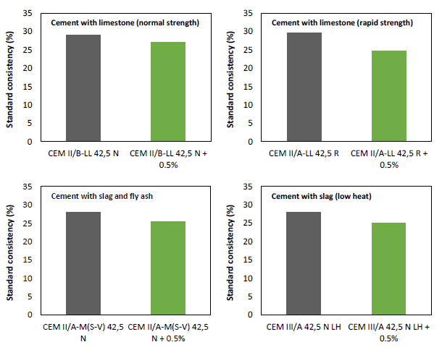
Standard consistency
All mixtures with the addition of inhibitors have a reduced need for water and greater workability
CEM II/A-LL 42.5 R - water requirement is reduced by 17% with the addition of inhibitors compared to the mixture without inhibitors

Slide 12
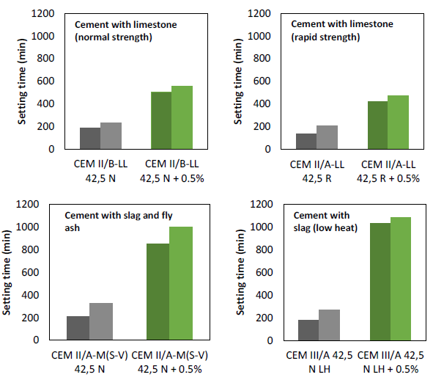
Setting time
The requirement according to the HRN EN 197-1 standard for a minimum initial setting time of 60 minutes is met by all tested mixtures
The initial setting time is prolonged in the case of the addition of inhibitors in all cements
The least significant increase in the initial and final setting time - cements with limestone
The most significant increase in setting time - cements with slag

Slide 13
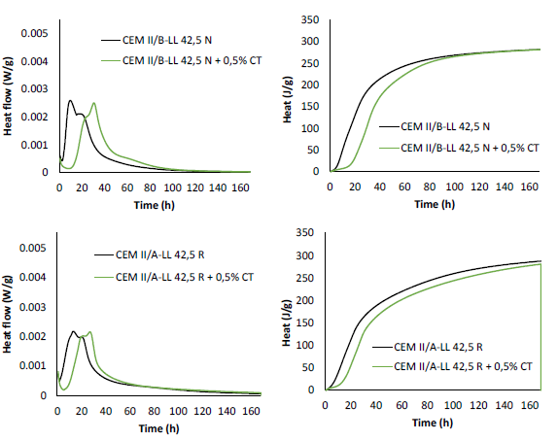
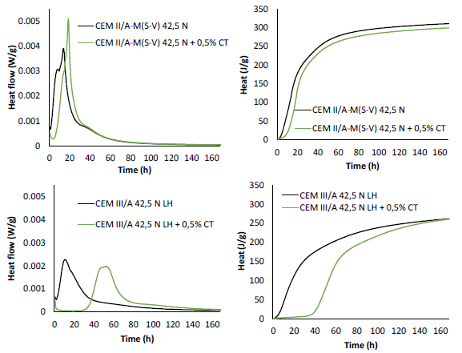
Heat of hydration

Slide 14
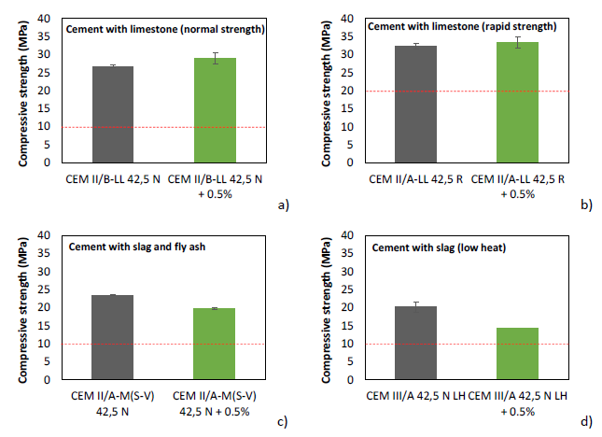
Mechanical properties
All cements with or without inhibitors meet the specified criteria for compressive strength after 2 days for cements marked N (≥10.0 MPa) and cements marked R (≥20.0 MPa)
Slight increase in early compressive strength for limestone cements
Slight reduction of early compressive strength for cements with fly ash and slag

Slide 15
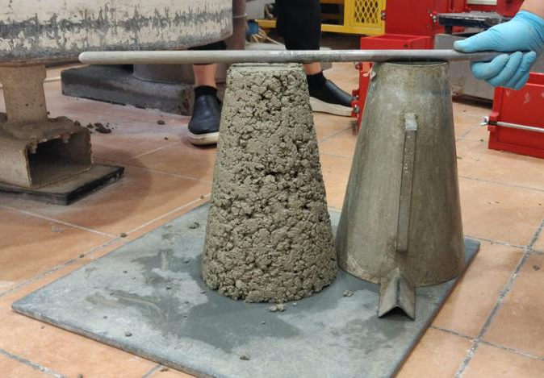
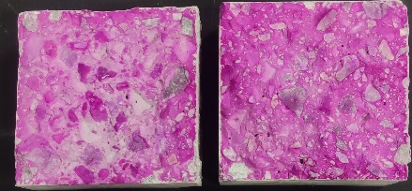
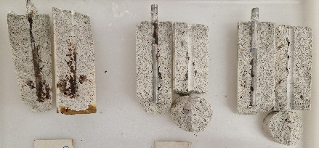
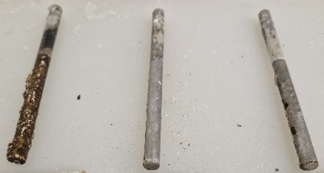
INFLUENCE ON CONCRETE
Cement type | Label
Portland cement with the addition of limestone CEM II/B-LL 42.5 N | CEM II
Portland cement with the addition of limestone CEM II/B-LL 42.5 N + 0.1% inhibitor | CEM II + 0.1%
Portland cement with the addition of limestone CEM II/B-LL 42.5 N + 0.25% inhibitor | CEM II + 0.25%
Portland cement with the addition of limestone CEM II/B-LL 42.5 N + 0.5% inhibitor | CEM II + 0.5%

Slide 16
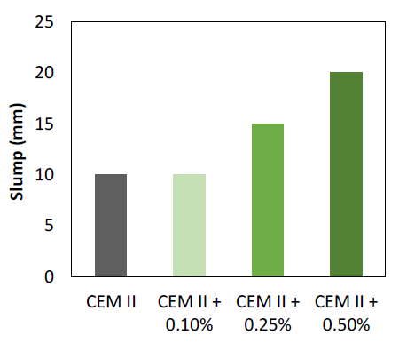
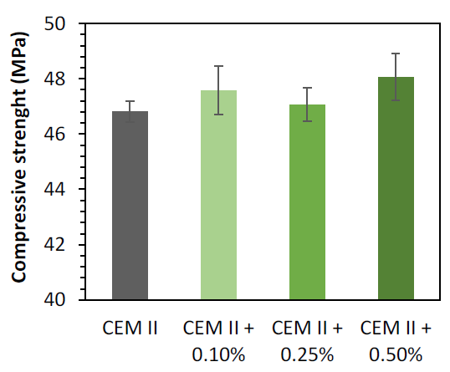
Workability and compressive strength
By increasing the proportion of the MCI-2006 NS, the slump value of the fresh mixture also increases, which means that workability increases - favorable influence
Increasing the proportion of the MCI-2006 NS the mean value of the compressive strength compared to the reference mix (CEM II) increases - favorable influence

Slide 17
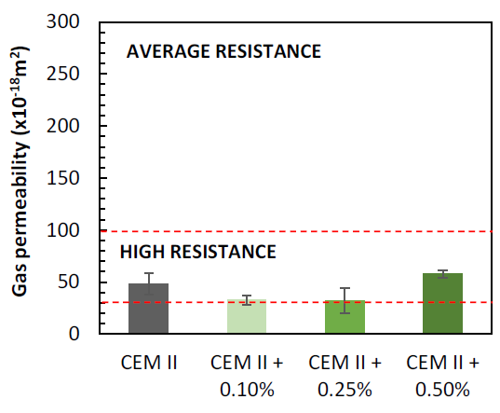
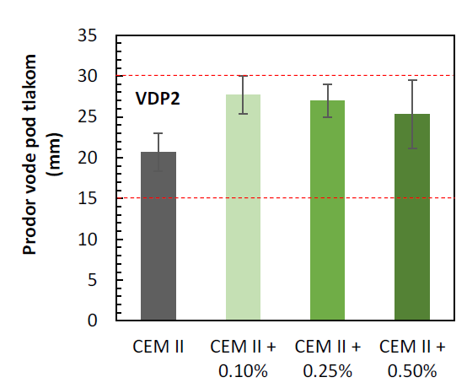
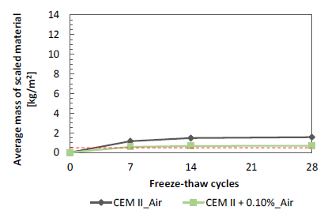
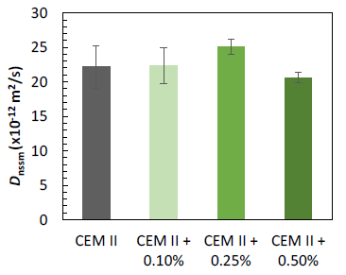
Durability properties
The inhibitor added in any of the three tested amounts has no significant effect on the durability properties of concrete
For application in cold climates air entraining additive is necessary - tests have proven the compatibility of inhibitors with air entrainer

Slide 18
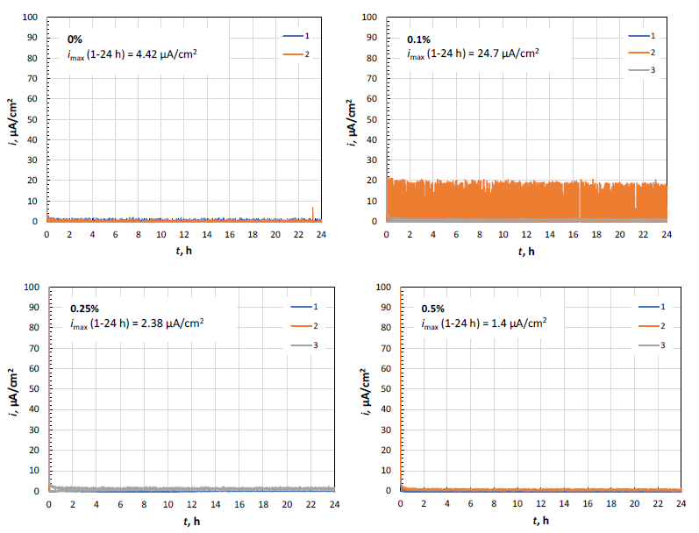
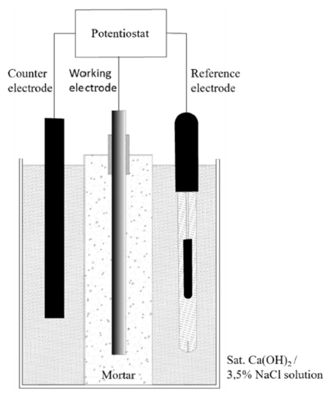
Corrosion behaviour
According to HRN EN 480-14 tests were carried out in a passive solution of saturated calcium hydroxide
500 mV polarisation

Slide 19
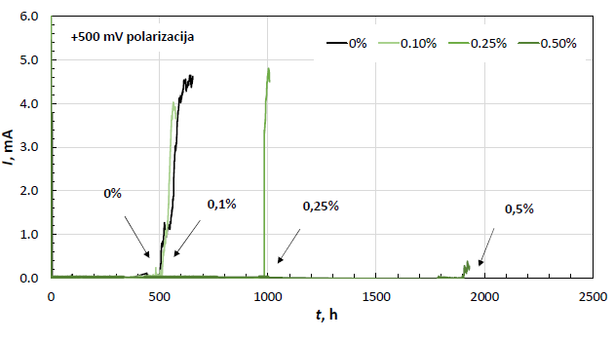
Corrosion behaviour
The tests were carried out in a 3.5% NaCl, polarisation 500 mV vs SCE
Polarization caused corrosion currents below 200 μA/cm² – realistic, significant duration of test (up to 3 months)
0.1% - time-to-corrosion the same
as control
0.25% - time-to-corrosion prolonged
2 times compared to control
0.5% - time-to-corrosion prolonged
3.8 times compared to control

Slide 20
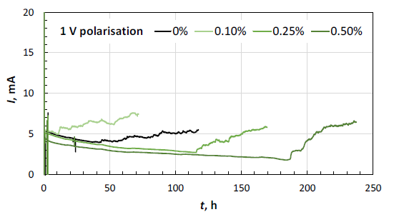
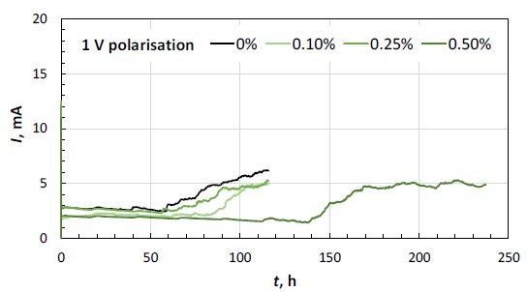
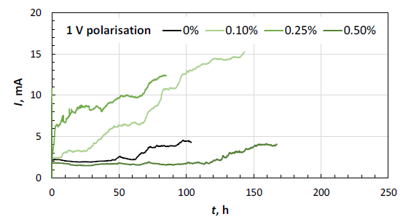
Corrosion behaviour
The tests were carried out in a 3.5% NaCl, polarisation 1000 mV vs SCE
Polarization caused corrosion currents above 200 μA/cm² – potentially unrealistic, shorter duration of test
0.1% - no significant effect on retardation of the corrosion process
0.25% - the retardation of the corrosion process in the first set of samples – 3 times
0.5% - the retardation of the corrosion process in all sets – 3 to 5 times

Slide 21
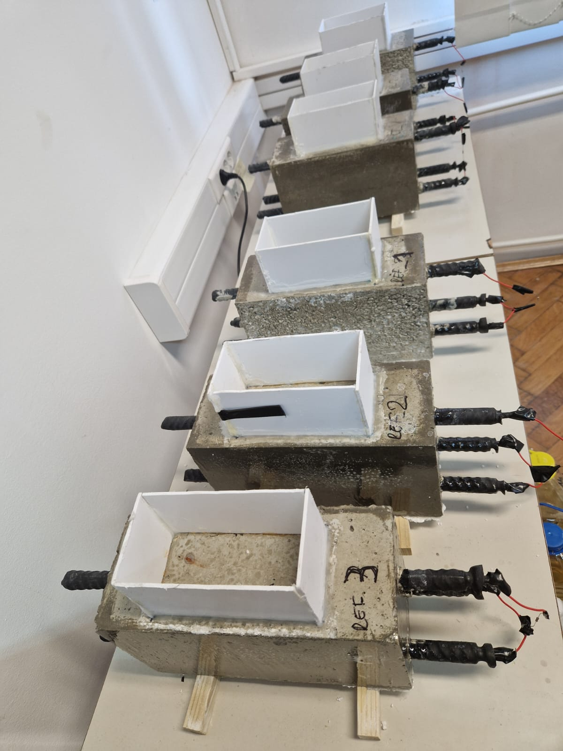
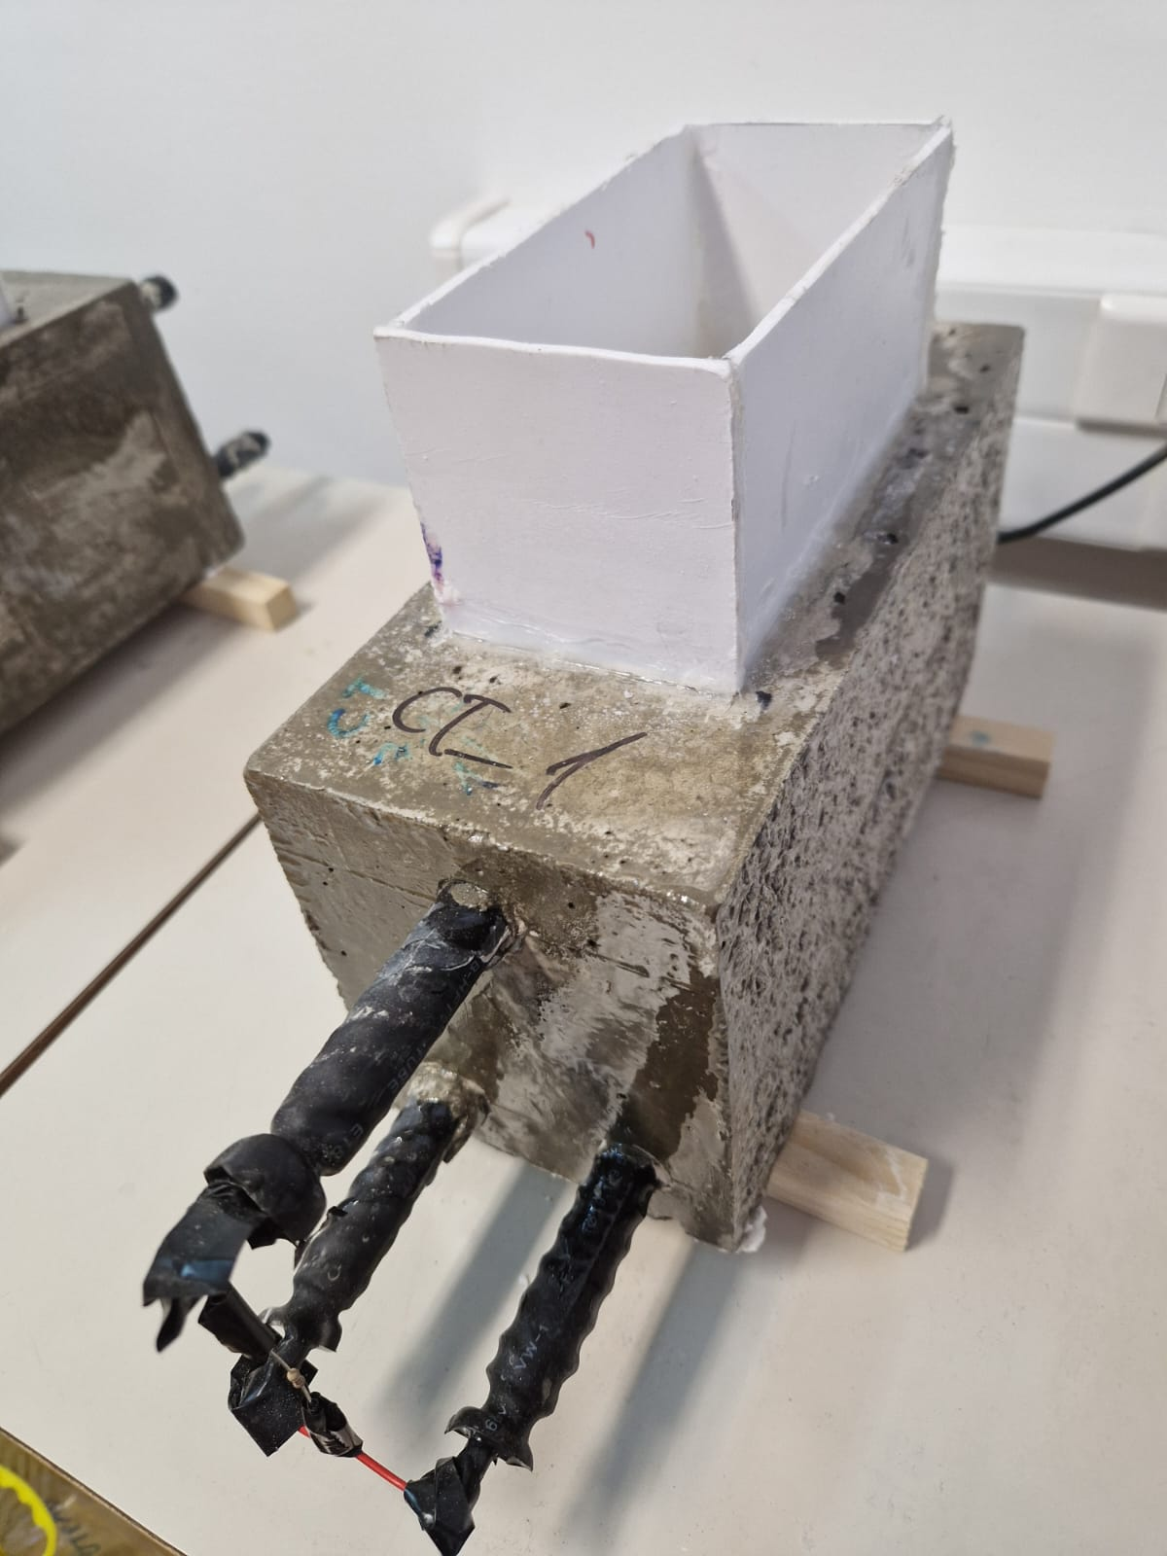
Corrosion behaviour
ASTM G109 - 07 Standard Test Method for Determining Effects of Chemical Admixtures on Corrosion of Embedded Steel Reinforcement in Concrete Exposed to Chloride Environments – results to follow

Slide 22
Conclusions
Newly developed cement with the addition of MCI-2006 NS (0.5% by mass of cement) causes an increase in the workability of cement paste and concrete, and slows down the setting and causes slight increase in the compressive strength of cement and concrete, especially of cement early 2-day strength – beneficial for warm climates
In case of freezing and thawing, the compatibility of inhibitor and air entrainer (additive to increase the resistance of concrete to freezing and thawing) has been proven – inhibitor slightly improves the efficiency of the air entrainer – beneficial for cold climates

Slide 23
Conclusions
In the case of lower acceleration of corrosion by polarisation, 0.25% and 0.5% of the inhibitor per mass of cement are effective in retarding corrosion
When corrosion is greatly accelerated by polarisation, only 0.5% of the inhibitor
per mass of cement retards the time-to-corrosion compared to concrete with cement without inhibitors
The addition of 0.25% inhibitor to the mass of cement slows down corrosion
by about 2 times, while the addition of 0.5% inhibitor to the mass of cement
slows down corrosion by about 4 times

Slide 24
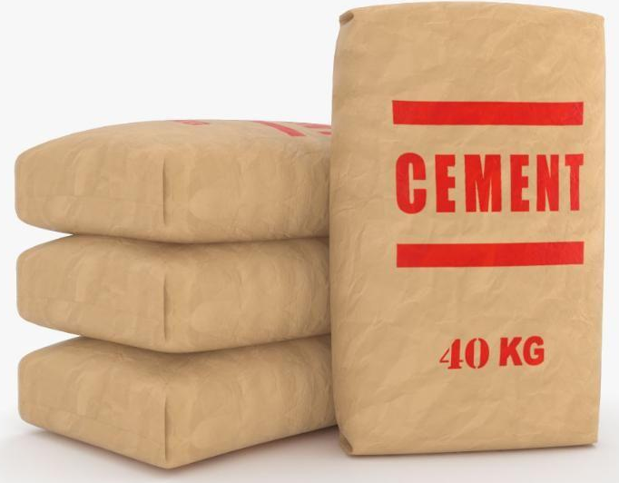
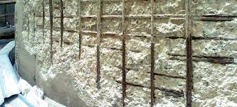
Conclusion
With the newly developed cement the rate of corrosion is effectively slowed down, while the workability and mechanical properties of concrete are improved, and all other durability properties are kept within the same resistance category as with cement without inhibitors
CORROSION INHIBITING

Slide 25
THANK YOU FOR YOUR ATTENTION!
marijana.serdar@grad.unizg.hr

