Slide 1
Inhibition of Microbial Induced Corrosion of Concrete using Admixture and Surface Applied Corrosion Inhibitors
Behzad Bavarian, FNACE, Lisa Reiner, Pranav Maddhali
California State University, Northridge
18111 Nordhoff St
Northridge, CA 91330
and
Koushik Kosanam
Ohio State University
2136 Fontana Labs 140 W. 19th Ave. Columbus, Ohio 43210

Slide 2
‘Major Structural Damage’ at Surfside Florida Condo Complex due to corrosion of reinforced concrete, June 24, 2021

Slide 3
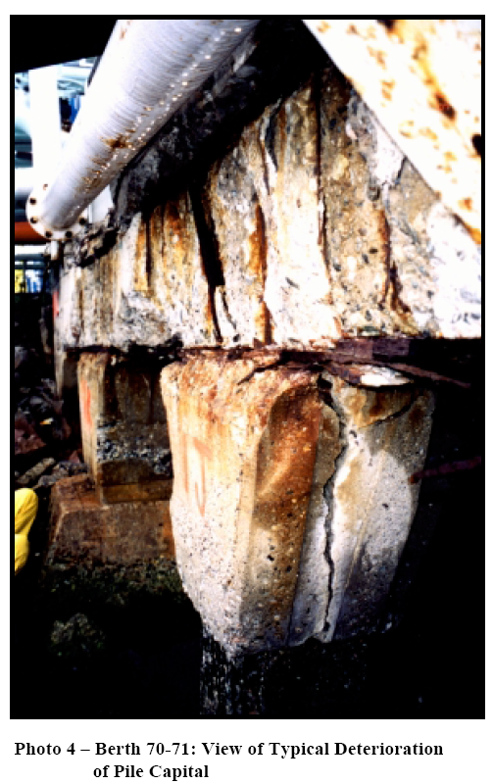
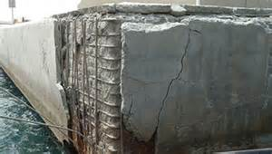
Concrete structures Deterioration

Slide 4
Objective of our research program
Corrosion is one of the primary concerns in the durability of structures.
Past 25 years research efforts have been made to find corrosion protection and inhibition processes to prolong the life of existing structures and minimize corrosion damages in new structures.
Research Significance
Can we use of admixtures, migrating corrosion inhibitors and surface applied corrosion inhibitors that are very effective in high chloride environment to inhibit MIC?

Slide 5
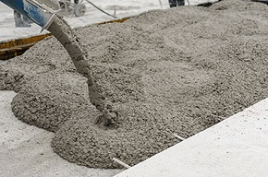
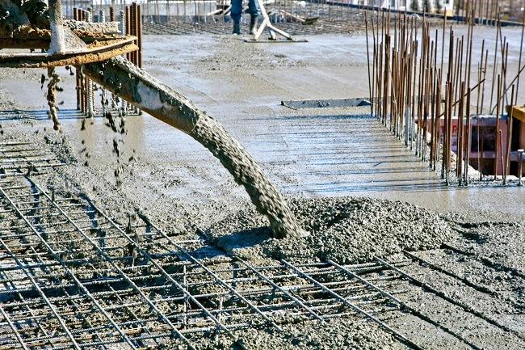
Concrete curing reactions
2(3CaO.SiO₂) + 6H₂O = 3CaO.2SiO₂.3H₂O + 3Ca(OH)₂
(Tricalcium silicate) (Tobermerite gel)
2(2CaO.SiO₂) + 4H₂O = 3CaO.2SiO₂.3H₂O+Ca(OH)₂
(Dicalcium silicate) (Tobermerite gel)
3CaO.Al₂O₃ + 12H₂O + Ca(OH)₂ = 3CaO. Al₂O₃. Ca(OH)₂.12H2O
(Tricalcium aluminate) (Tetra-calcium aluminate hydrate)
- C₃S hardens rapidly: responsible for early strength
- C₂S hardens slowly and responsible for strength gain beyond one week
The water quality is critical not to take away any Ca ions from the binding gel
otherwise lower concrete strength

Slide 6
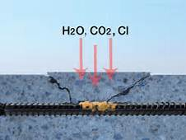
Corrosion Damages

Slide 7
Protection of steel rebar in Concrete
Clean Concrete
Cathodic Protection
Admixtures and Corrosion Inhibitors
Migrating Corrosion Inhibitors (MCI) or Surface Applied Corrosion Inhibitors(SACI)

Slide 8
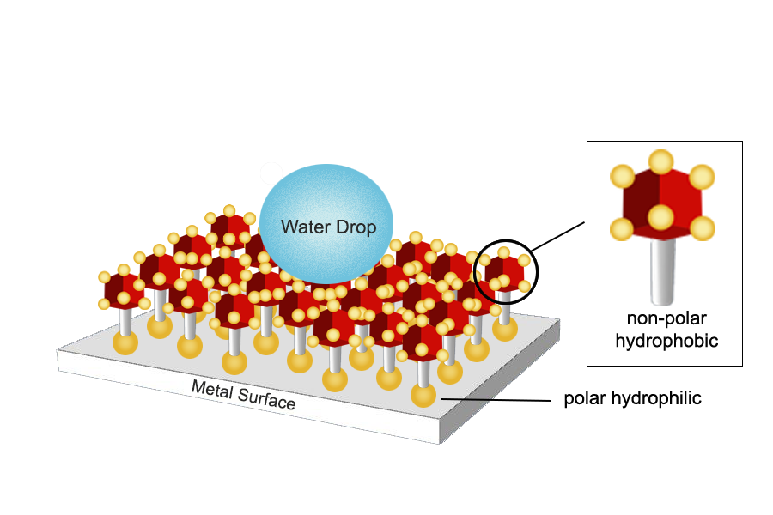
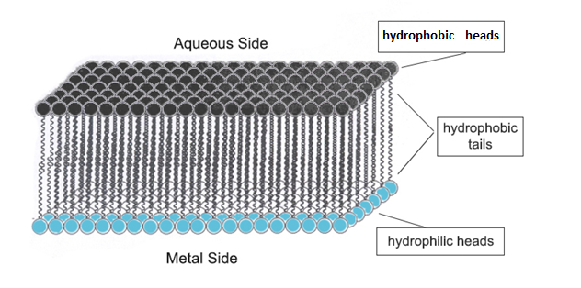
How Admixture/Inhibitor works?
Migrating corrosion inhibitors (MCIs) are developed to protect steel rebar from corrosion in concrete. They were designed to be incorporated as an admixture during concrete batching or used for surface impregnation of existing concrete structures. Under Chlorine Attack and Carbonatation Attack
MCI use compounds that work by forming a monomolecular film between the metal and the water. In Film Forming Inhibitors, one end of the molecule is hydrophilic and the other hydrophobic.

Slide 9
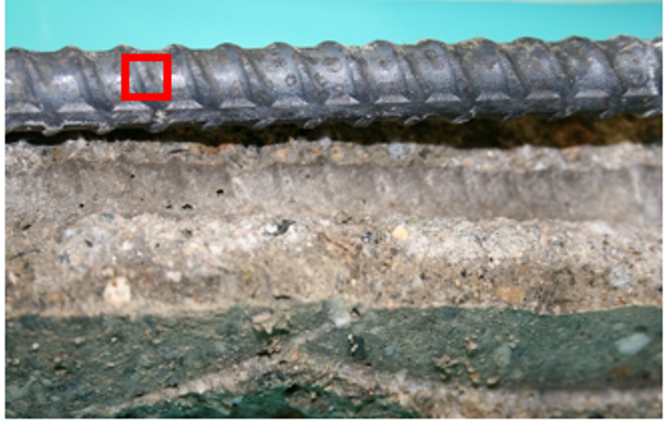

Slide 10
Polarization Resistance (R_{p}) Versus Time; Comparison of Inhibitor treated concrete with Control concrete samples.

Slide 11
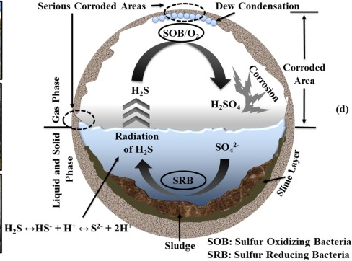
Current Research Project
Microbially-induced corrosion of Concrete Structures

Slide 13
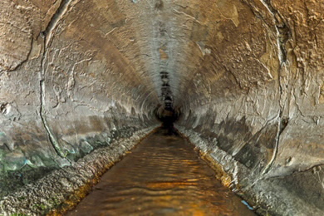
MIC effects: Production of hydrogen sulfide and concrete-destroying sulfuric acid, SRB (Sulfate Reducing Bacteria) SO4⁼ + 2 H⁺ + 4 H2 → H2S↑ (H+/HS-)+ 4 H2O

Slide 14
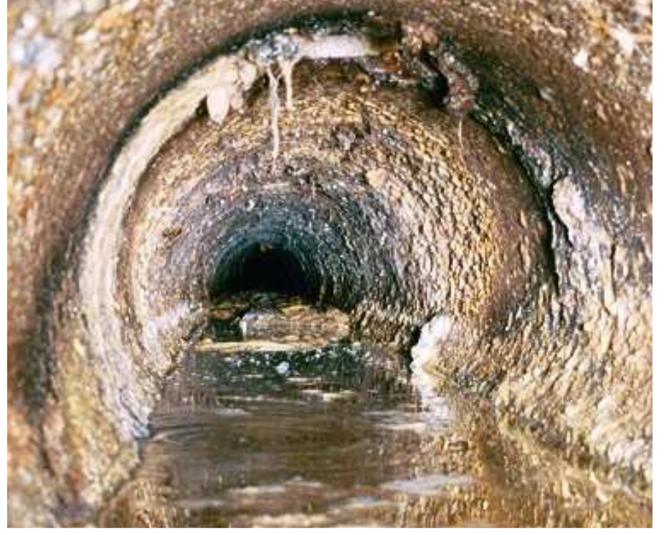
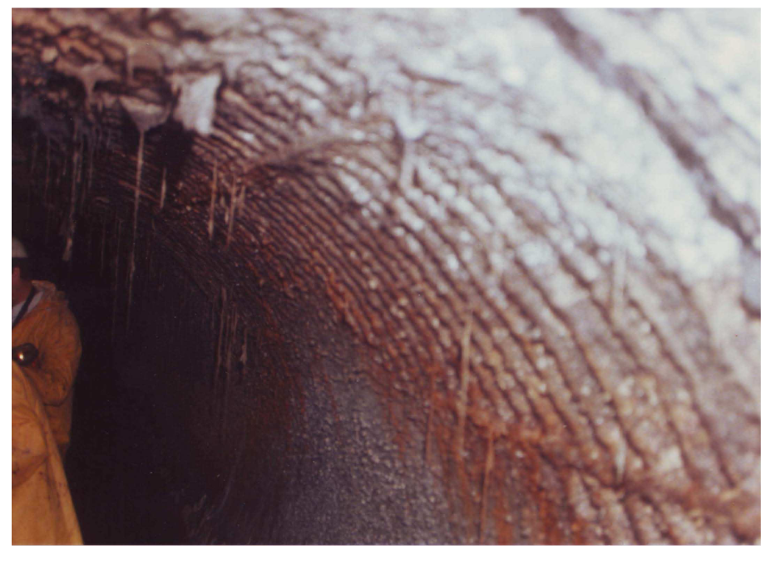
Formation of gypsum is an expansive reactions (white powdery deposits) , lower concrete strength, overstressing, cracking and spalling, mainly due to SOB reactions

Slide 15
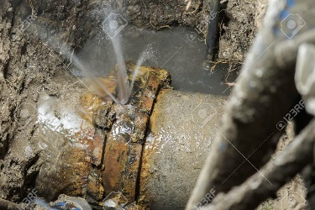
Sewer system Rehabilitation cost ~ $4 billion for LA County

Slide 16
Worst-Case Scenario for Sulfate attacks in sewer systems
The conditions that lead to excessively high sulfide/sulfate production are listed below :
Warm annual sewage temperatures (Average > 70 ºF)
Long force mains and/or flat sewers with debris
High BOD, (biochemical oxygen demand) wastewater (> 250 mg/L)
High sulfate wastewater concentrations (> 50 mg/L)

Slide 17
Deterioration of reinforced concrete in sewer environments
Billions of dollars are being spent worldwide on the repair and maintenance of sewer systems and wastewater treatment plants. Microbially-induced corrosion causes damage via micro-organisms. Deterioration is caused by acid excretion which etches the surface of concrete, penetrating the mortar surface, especially in sewer systems. The mechanisms of concrete and reinforcement deterioration in sewer environments and microbially-induced corrosion (MIC) is very complex.
The role of hydrogen sulfide and micro-organisms( SRB and SOB) in the deterioration of concrete in sewer environments and of repair and rehabilitation measures, including the following preventative measures:
modification of the materials used in construction of sewer pipes;
coatings;
sewer treatments.

Slide 18
How to protect concrete against MIC?
Chlorine compounds such as bleach, sodium hypochlorite, calcium hypochlorite and ferric chloride and calcium nitrate salt are examples of chemicals that are effective in controlling H2S in wastewater collection systems and used by municipalities to control hydrogen sulfide-related odors and corrosion on a daily basis. However, chloride rich compounds can promote corrosion of reinforcement rebars.
Migrating corrosion inhibitors and Surface applied Corrosion inhibitors appear to be a better alternative than nitrate and chloride rich compounds and more environmentally friendly chemical.
In this research project, Commercially available Inhibitors and Admixture were evaluated.

Slide 19
EXPERIMENTAL PROCEDURE
A concrete mixture (4 Aggregate: 2 Sand: 1 Portland Cement type II with moderate sulphate resistant hydraulic cement) was used to make the concrete (0.5 W/C ratio). The premixed concrete was used to cast 5x10 cm (2 inch x 4 inch) cylinders. Curing and compression tests were done per ASTM C31 and ASTM C39 standards, the compressive strength was on average 5,400 psi after four weeks of curing.
Four types of samples were prepared: 1) samples surface coated with migrating corrosion inhibitor; 2) samples made with admixtures; 3) samples made with 5% admixtures and coated with surface applied migrating corrosion inhibitors; and 4) control samples (no admixtures, no corrosion inhibitor coatings).
Three layers of the surface applied migrating corrosion inhibitor (SACI-A and SACI-B) were applied to the cylindrical samples after curing and prior to the immersion corrosion tests.

Slide 20
Sulfate attack layer thickness after 400 days exposure to highly acidic solution shows that Admix-A+SACI-B have the lowest sulfate reactions

Slide 21
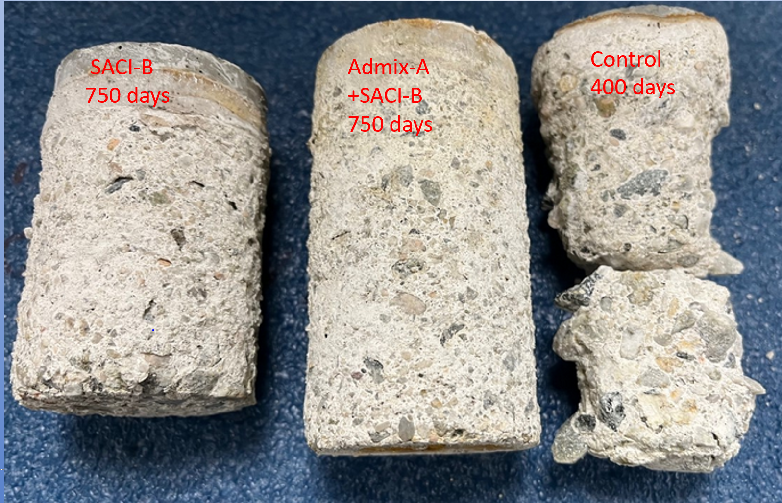
Sulfate attack layer thickness after 750 days exposure to highly acidic solution shows that Admix-A+SACI-B and SACI-B still maintained their strength

Slide 22
Comparison of compressive behavior for concrete samples after 400 days of immersion tests. The combination of Admix-A +SACI-B had the best performance in highly acidic solution.

Slide 23
Comparison of sulfate attacks for 200 and 400 days exposure to highly acidic solution. SACI-B and Admix-A have the lowest sulfate attack reactions.

Slide 24
Sulfate attack layer thickness after 400 days exposure to highly acidic solution

Slide 25
Etched micrographs of the concrete control samples after immersion for 200 days, shows severe sulfate attacks and cracking of the concrete due to severe chemical MIC attacks.

Slide 26
Comparison of concrete sections used to measure the sulfate attack layer thickness after 200 days, both Admix-A and SACI-B are very effective resisting sulfate attack. The control sample showed more than 24.5% thickness, (etched with Phenolphthalein).

Slide 27
Comparison of Concrete sections used to measure the sulfate attack layer thickness after 400 days.

Slide 28
Conclusions
Microbiologically influenced corrosion of concrete was investigated in a highly acidic solution +300 sulfide (similar to SRB and SOB attacks) for more than 400 day. The concrete control samples suffered severe corrosion attack, presenting with a very thick sulfate layer, surface etching, disintegration of concrete (more than 12.0 mm) and significant loss of compressive strength, more than 78% after 400 days exposure
Admixture-A and surface applied SACI-B, a super hydrophobic corrosion inhibitor, showed excellent protection for the concrete samples without any loss of strength and a very thin layer of sulfate attack (~0.1-0.5 mm) for 200 day immersion tests. After 400 day immersion tests the strength loss for these samples was less than 8%.
Admixture-A and surface applied SACI-B has showed a minimum chemical attacks (deterioration), still maintained ~90% of concrete strength after 750 days
SACI-A showed some improvement and protection in the short term, however, due to its low surface adhesion, ultimately, the concrete samples showed some strength loss due to the sulfate attack after 150 days of exposure tests.
In summary, to assure a satisfactory performance for concrete structures (such as manhole, channels and pipes) in aggressive (sulfate rich) waste water systems, a combination of admixture-A and surface applied (highly hydrophobic) SACI-B is recommended.

Slide 29
The Peljesac Bridge Croatia’s Adriatic coastline. July 2022
The USD $500M, 2.4-kilometre beam and cable-stayed structure, protected by Surface Applied Corrosion inhibitor and Migrating Corrosion Inhibitor admixture.
Questions?

